Slide 1
PETMON
All in One tracker for your Pet

Slide 2
ARE YOU A PET OWNER?
then YOUR PET’S health must matter to you

Slide 3
THEN why NOT
TRACK YOUR PET’S ACTIVITIES ?

Slide 4


Slide 5
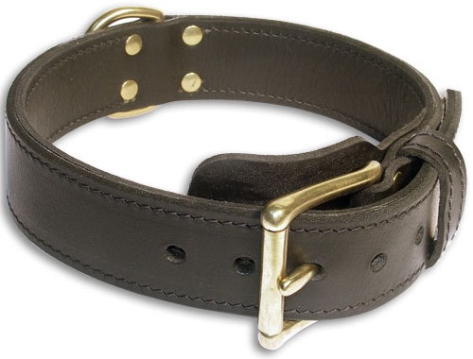
Pulse
Rate
Calories Burnt
Body Temperature
Sleeping
Pattern

Slide 6

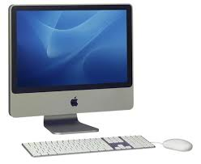
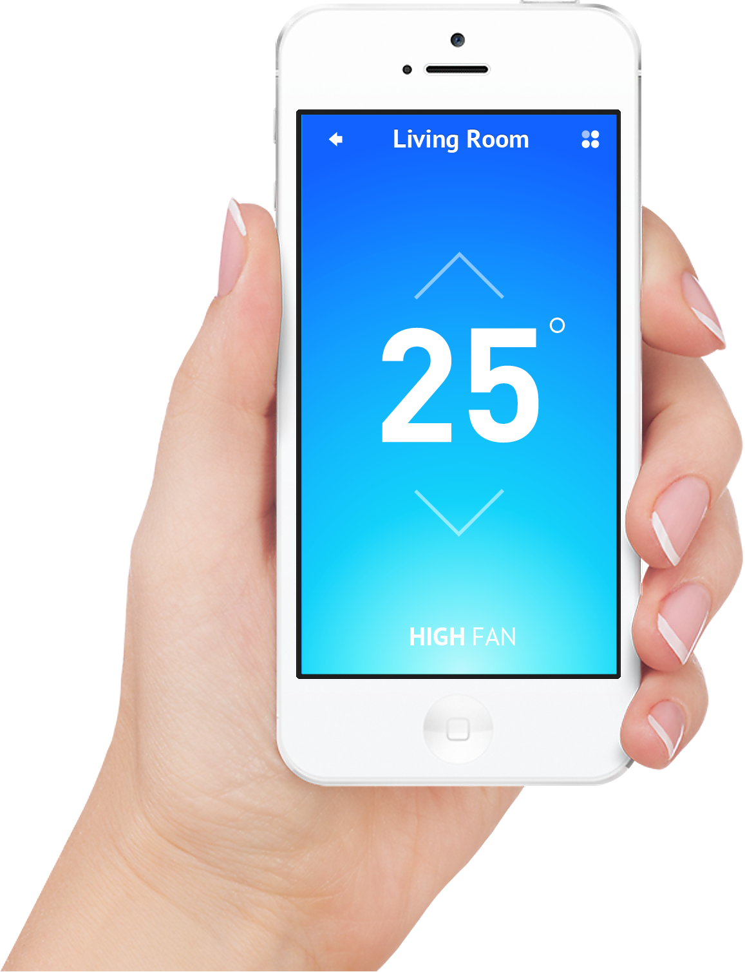
Belt
Cloud
Website
Mobile App

Slide 7

PETMON
Sign Up
OR
Login

Slide 8
PETMON
Home
Nearby Doctors
Appointments
Contact Us
 | Now | Today | Yesterday
Pulse Rate | … | … | …
Body Temperature | … | … | …
Calories Burnt | … | … | …
This Month

Slide 9
PETMON
 | Now | Today | Yesterday
Pulse Rate | … | … | …
Body Temp | … | … | …
Calories burnt | … | … | …

Slide 10
MONTHLY REPORT

